Slide 1
Crafting Compelling
Web Presences

Slide 2
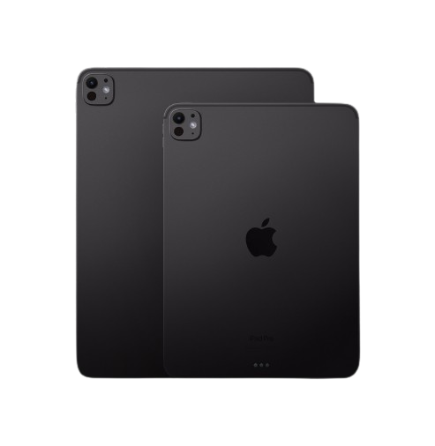
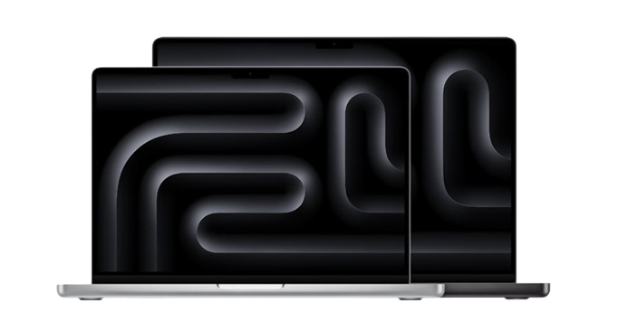
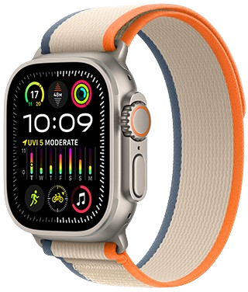
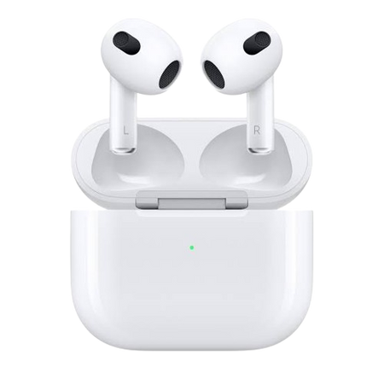
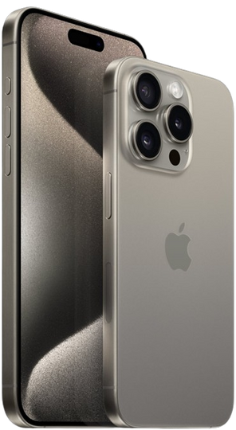
Products of Apple
01
02
03
04
05

Slide 3

Display
iPhone
Battery
6.7-inch Super Retina XDR OLED with ProMotion technology, offering a 120Hz refresh rate for fluid visuals and touch responsiveness.
Enhanced battery life that ensures longer usage between charges.
Performance
Build
Powered by the A17 Pro chip, ensuring top-notch performance, energy efficiency, and enhanced graphics capabilities.
Constructed with a durable titanium frame for a premium feel and increased durability.
Camera
Software
A sophisticated triple-camera system with advanced optical zoom, improved low-light performance, and new computational photography features. It supports ProRAW and ProRes video recording for professional-quality media creation.
Operates on iOS 17, offering a range of new features, improved privacy settings, and a redesigned user interface.

Slide 4
Display
ipad
Accessories
Comes with a Liquid Retina XDR display offering stunning brightness, color accuracy, and ProMotion technology for smooth visuals.
Compatible with Apple Pencil (2nd generation) and Magic Keyboard, making it a versatile tool for creativity and productivity.
Performance
Design
Powered by the M2 chip, delivering exceptional speed and graphics performance for demanding applications.
Sleek and portable design, making it easy to carry and use on the go.
Camera
Software
Advanced camera system with a 12MP Ultra Wide front camera and a 12MP Wide and 10MP Ultra Wide back camera, suitable for high-quality photography and AR applications.
Runs on iPadOS, which provides enhanced multitasking capabilities and a desktop-like experience.

Slide 5
Display
MacBook
Battery Life
Boasts a Liquid Retina XDR display with high brightness, contrast, and color accuracy, ideal for graphic-intensive work.
Features extended battery life, suitable for long work sessions without frequent recharging.
Models
Design
Available in 14-inch and 16-inch versions, catering to different portability and screen size preferences.
Features a robust and sleek build, with an improved keyboard and expansive touchpad for better user experience.
Chip
Ports
Powered by Apple's M1 Pro and M1 Max chips, providing unparalleled performance, especially for professional tasks.
Includes a variety of ports such as HDMI, SD card slot, and Thunderbolt 4, enhancing connectivity options.

Slide 6
Display
Apple Watch
Durability
Features a larger always-on Retina display for easy readability and interaction.
Enhanced durability with improved resistance to water and dust.
Health Monitoring
Safety Features
Includes advanced health monitoring capabilities like ECG, blood oxygen level, and body temperature sensing.
New safety features such as crash detection and emergency SOS, enhancing personal safety.
Fitness Tracking
Battery Life
Extensive fitness tracking with new workout types and advanced metrics.
Improved battery life, supporting longer usage between charges.

Slide 7
Sound Quality
AirPods
Fit
Enhanced sound quality with deeper bass and clearer highs for a superior audio experience.
Customizable fit with various ear tip sizes, ensuring comfort and secure fit.
Noise Cancellation
Battery Life
Active noise cancellation for immersive listening, and transparency mode to stay aware of your surroundings.
Extended battery life, providing up to 6 hours of listening time on a single charge, with the case offering additional charges.
Spatial Audio
Controls
Personalized spatial audio with dynamic head tracking for a surround-sound experience.
Improved touch controls for easier management of music, calls, and Siri activation.

Slide 8
Determine the platform on which the website is developed (Use online tools to identify).
Tools Used: Wappalyzer

Slide 9










Ecommerce
Webmail
Maps
Miscellaneous
Cart functionality
Apple icloud
Apple mapkit
Open graph
Security
Personalisation
A/B Testing
Analytics
HSTS
Adobe target
Adobe target
Adobe analytics
Javascript frameworks
JavaScript libraries
React
Lodash
Vue.js
Preact

Slide 10
Test the website's responsive design and mobile optimization (Share the report). Test a minimum of 5 pages (Use Online Tools to find)
Test the website's responsive design and mobile optimization (Share the report). Test a minimum of 5 pages (Use Online Tools to find)

Slide 11
Tools used
Google Chrome DevTools:
It offers a built-in feature that allows you to simulate how your website appears on various devices and screen sizes. Access it by right-clicking on your webpage, selecting "Inspect", then toggling the device toolbar.
Viewport Resizer:
Responsive design testing Google chrome extension

Slide 12
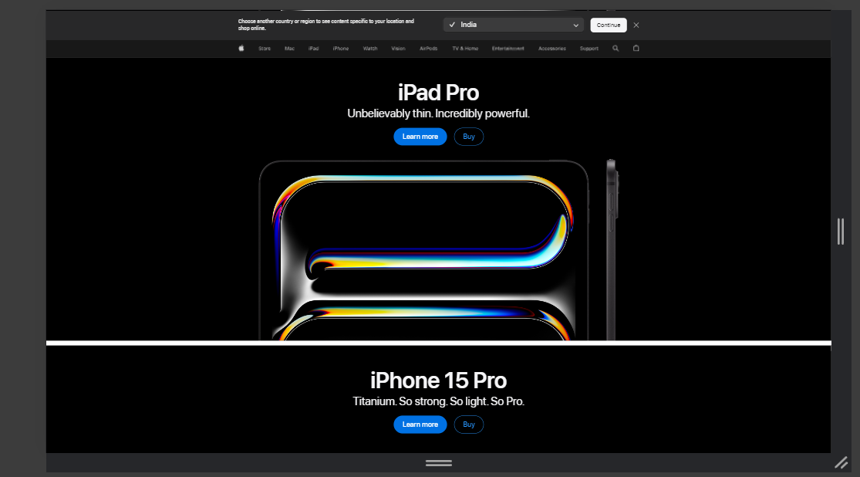
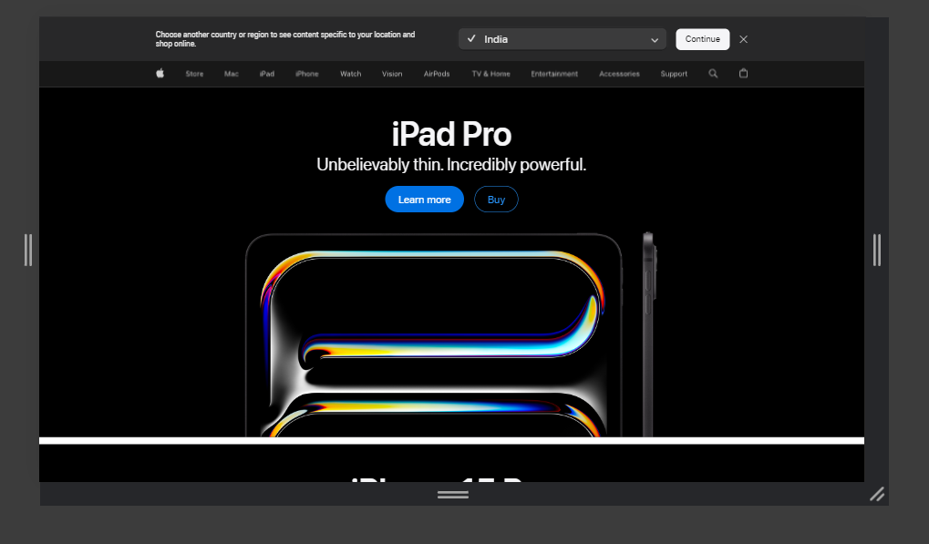
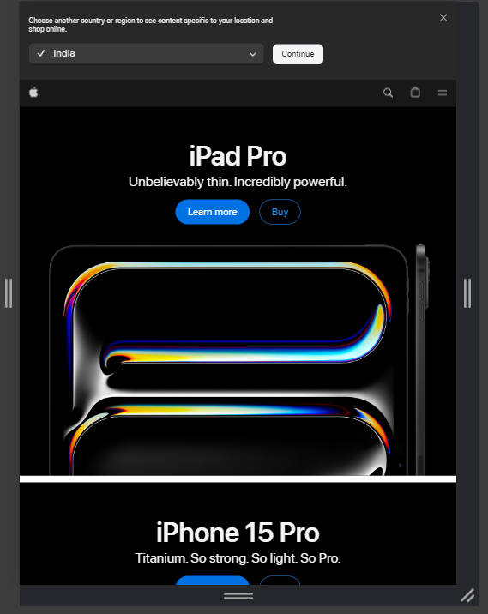
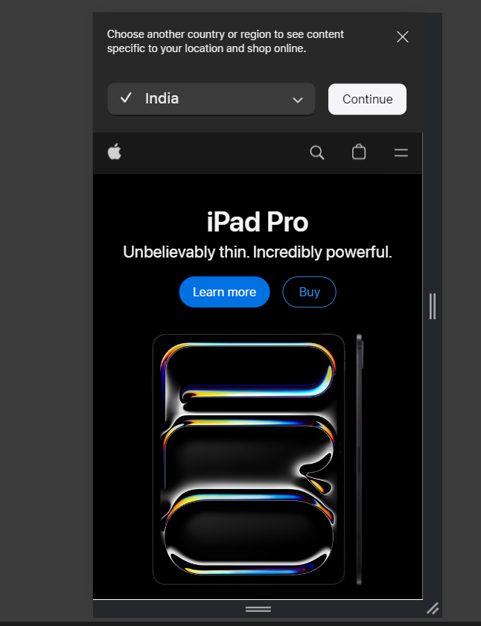
Desktop(full screen)
Laptop(medium screen
Width:1920x1080
Width1366x768
Tablet(portrait)
Home page
Mobile
Width:768x1024
Width:375x667

Slide 13
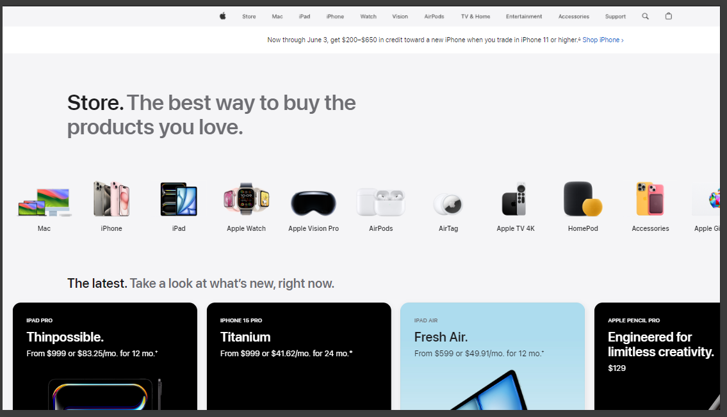
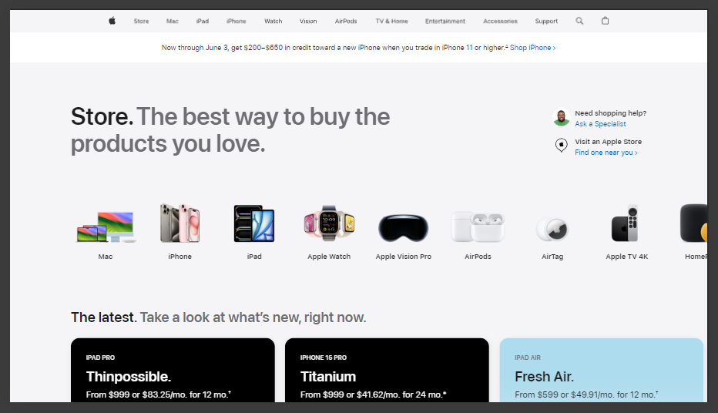
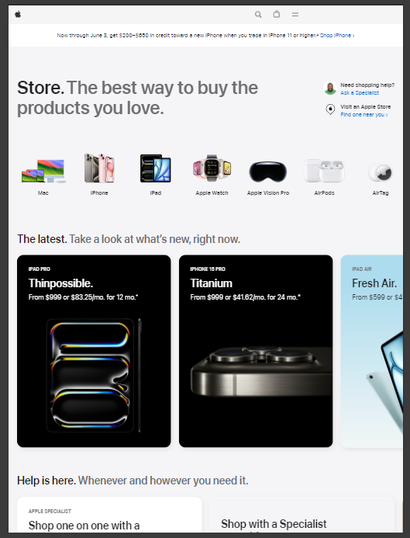
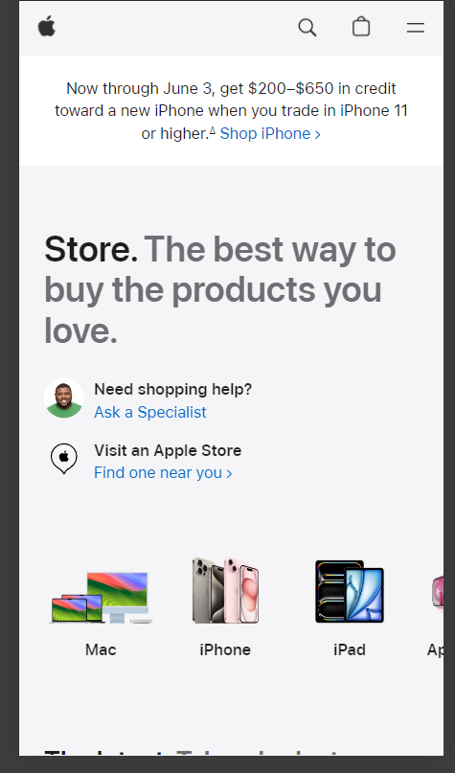
Desktop(full screen)
Laptop(medium screen
Width:1920x1080
Width1366x768
Tablet(portrait)
Store
Mobile
Width:768x1024
Width:375x667

Slide 14
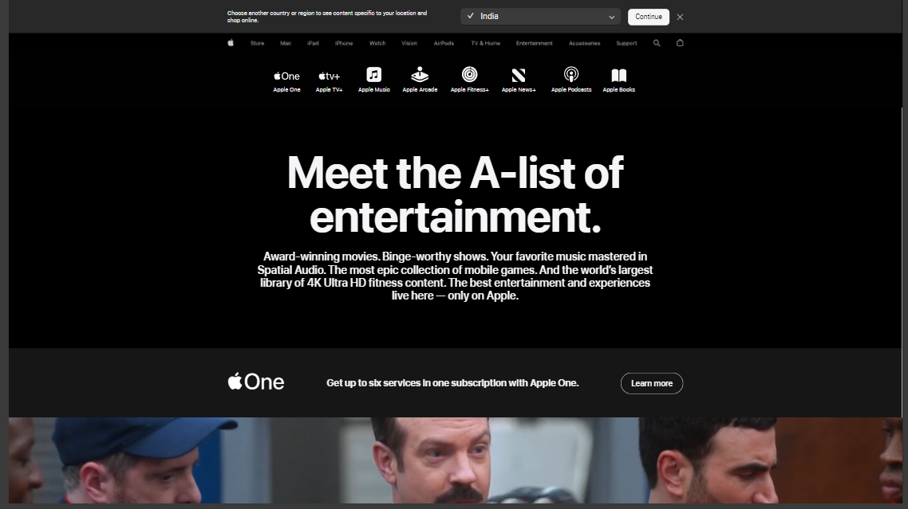
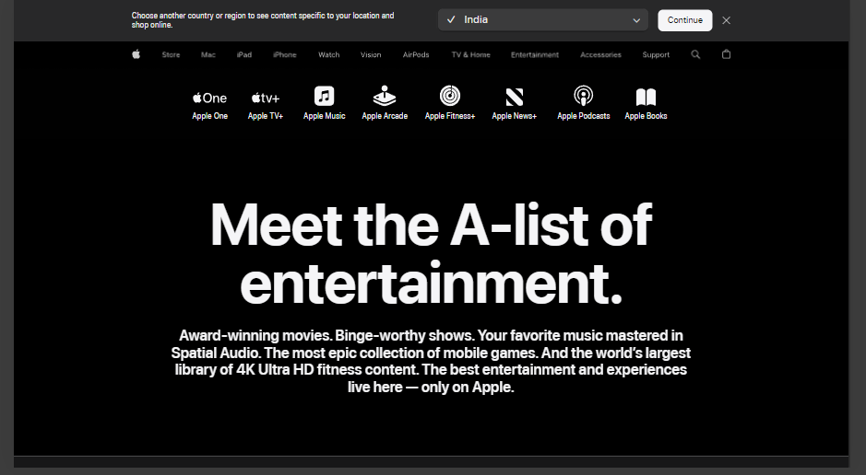
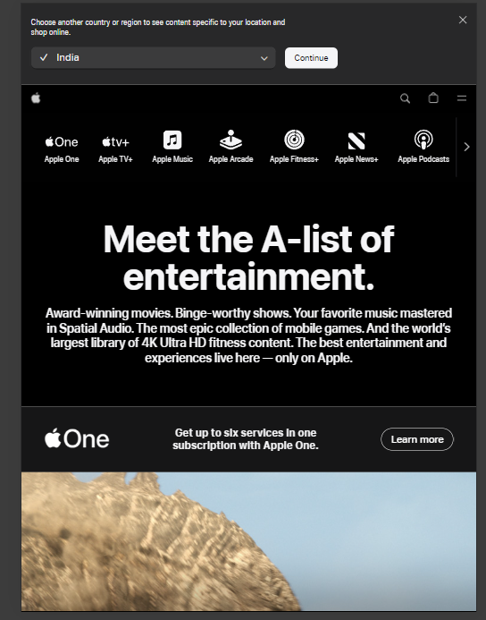
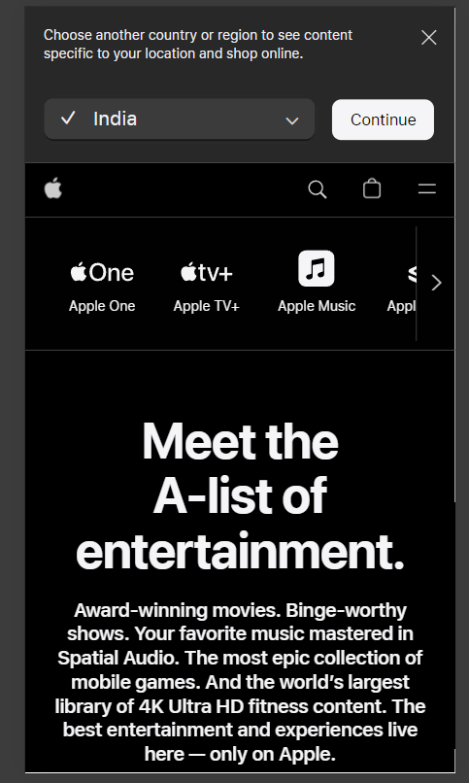
Desktop(full screen)
Laptop(medium screen
Width:1920x1080
Width1366x768
Tablet(portrait)
Entertainment
Mobile
Width:768x1024
Width:375x667

Slide 15
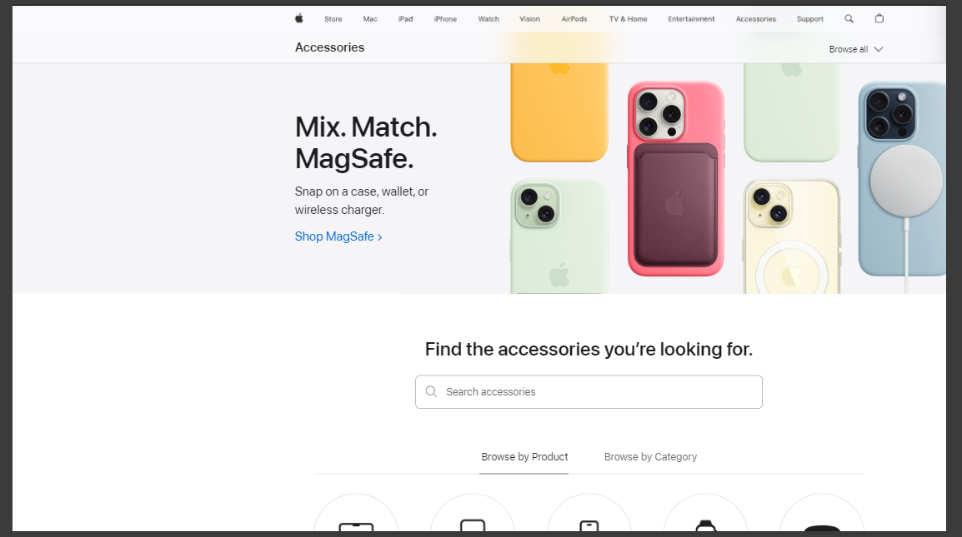
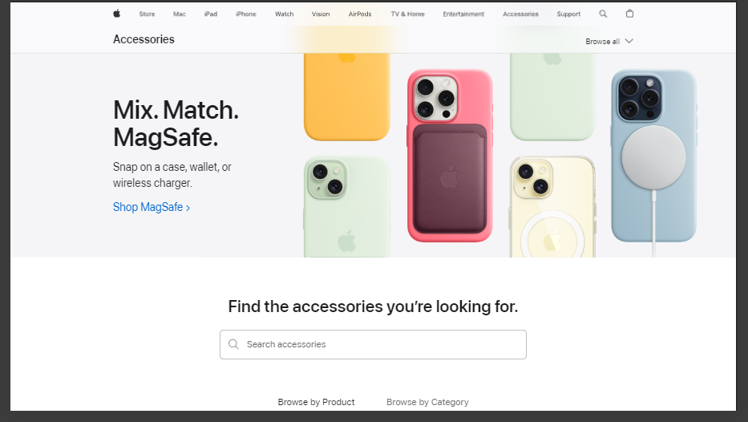
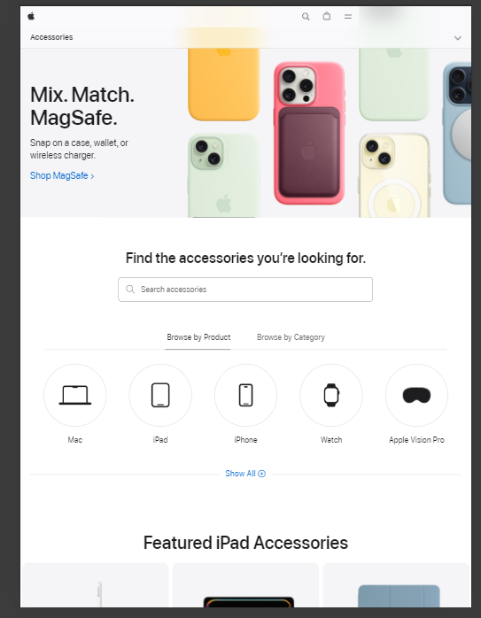
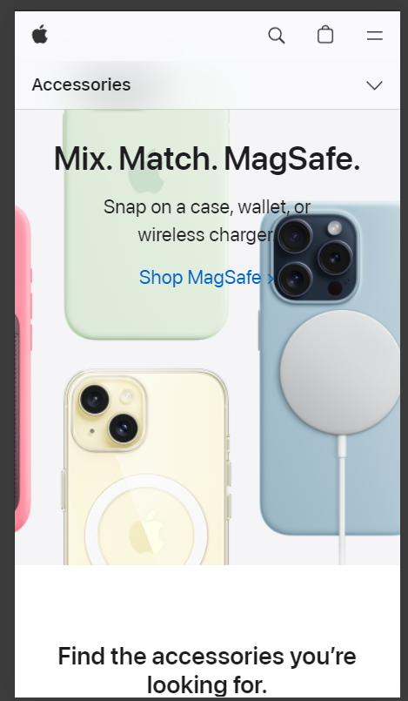
Desktop(full screen)
Laptop(medium screen
Width:1920x1080
Width1366x768
Tablet(portrait)
Accessories
Mobile
Width:768x1024
Width:375x667

Slide 16
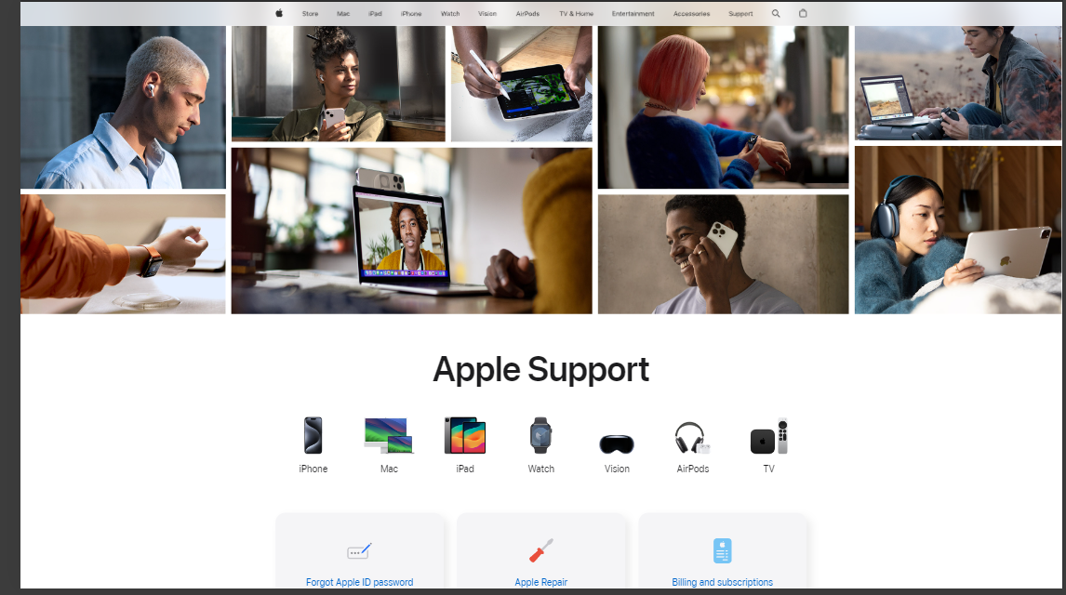
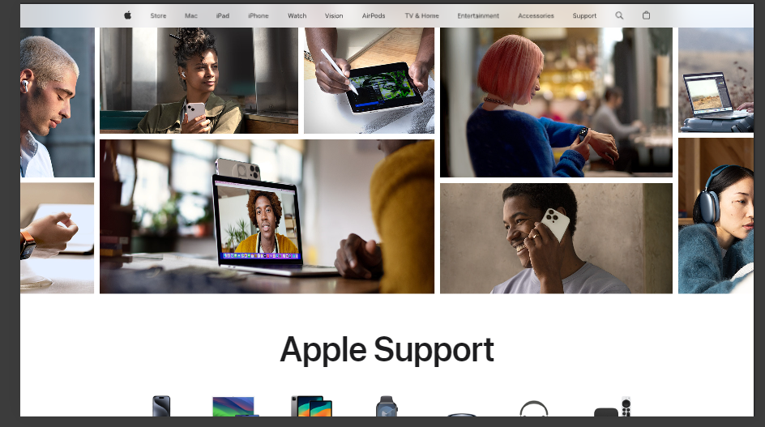
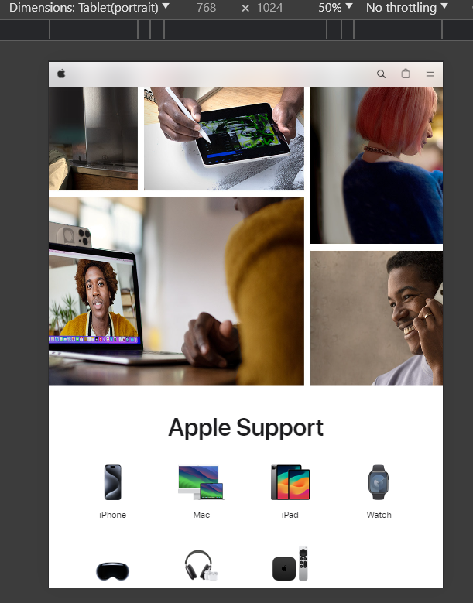
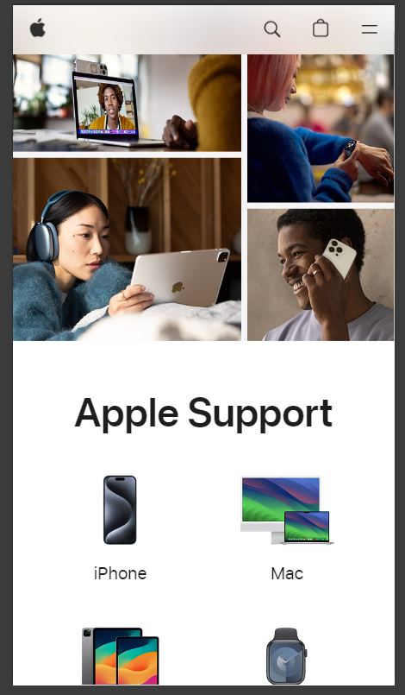
Desktop(full screen)
Laptop(medium screen
Width:1920x1080
Width1366x768
Tablet(portrait)
Support
Mobile
Width:768x1024
Width:375x667

Slide 17
Identify common website design mistakes to avoid, such as cluttered layouts and slow loading times. (List at least 5 suggestions).

Slide 18
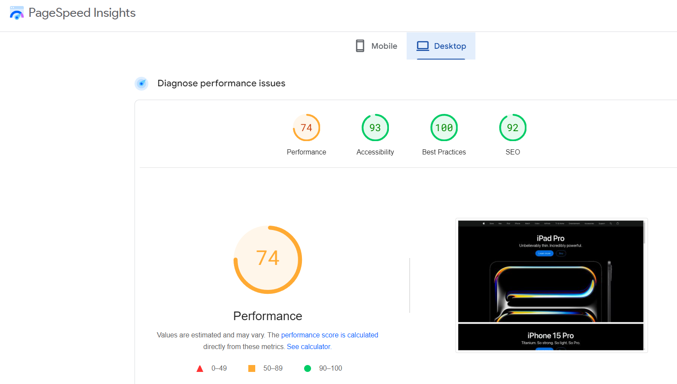
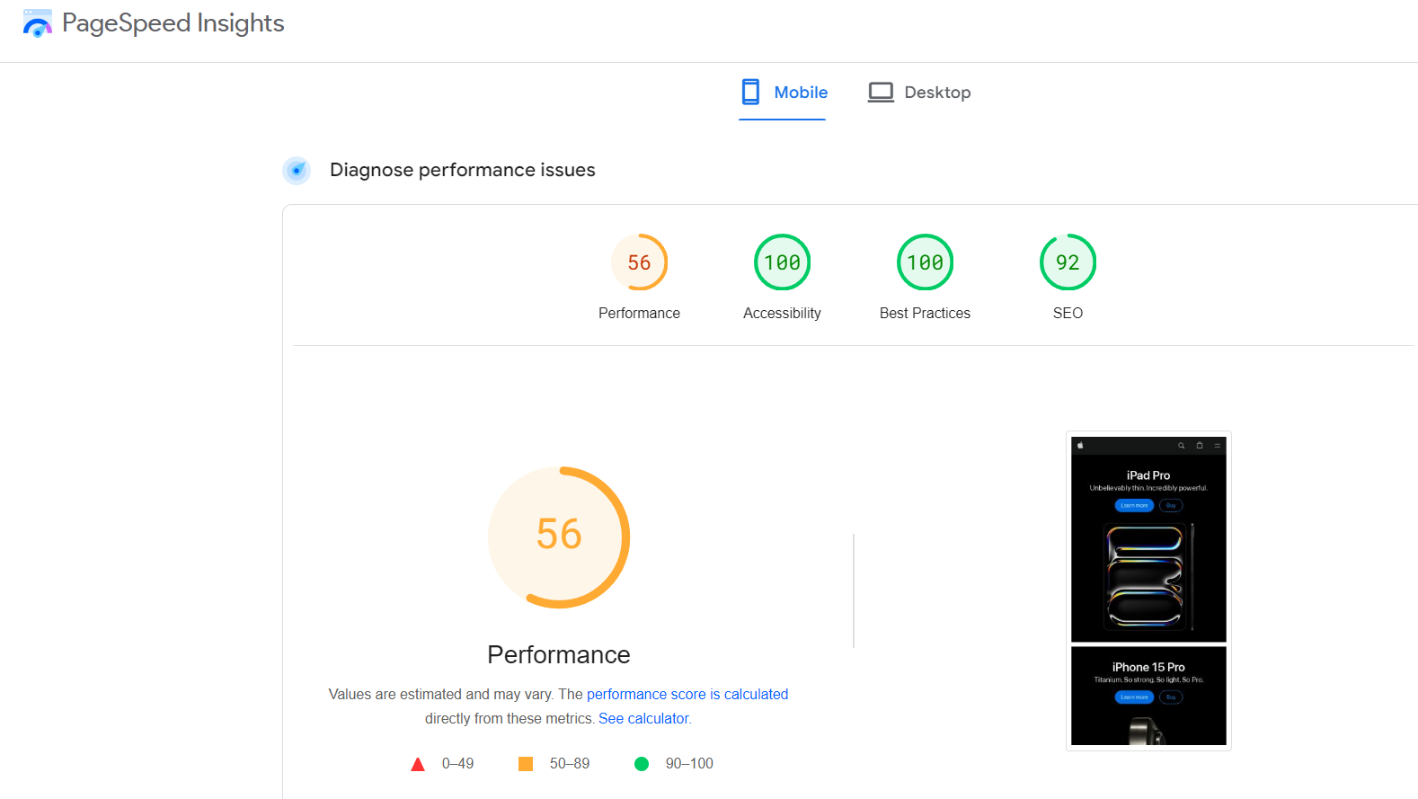
1. Optimized Loading Times
Issue:
Slow loading times can discourage users from exploring the site further. Large images and excessive scripts may contribute to delays in loading.
Solution:
Optimize images, minimize HTTP requests, and use efficient coding practices. Consider using a Content Delivery Network (CDN) and a reliable hosting provider to improve loading speed

Slide 19
Overemphasis on Visuals
Issue: Heavy reliance on high-quality images and animations can slow down loading times, especially on slower internet connections.
Solution: Optimize images and animations for faster loading times by using modern image formats (e.g., WebP), compressing files, and employing lazy loading techniques.

Slide 20
Complex Navigation for New Users
Issue: The sleek and minimalistic navigation can be somewhat non-intuitive for new users unfamiliar with Apple's ecosystem, potentially leading to confusion and difficulty finding information.
Solution: Simplify navigation by providing clear labels, incorporating a search function, and ensuring that the most critical sections are easily accessible from the homepage.

Slide 21
Lack of Clear Call-to-Action (CTA) Buttons
Issue: Sometimes the design prioritizes aesthetics over functionality, leading to less prominent or clear CTAs. This can confuse users about what action to take next, such as making a purchase or seeking more information.
Solution: Ensure that CTAs are visually distinct, use action-oriented language, and place them strategically where users' attention is most likely to be, enhancing the overall user journey.

Slide 22
Small Font Sizes
Issue: Some text elements on apple.com might have small font sizes, which can make it difficult for users, especially those with visual impairments, to read the content comfortably.
Solution: Increase the font size and ensure sufficient contrast between text and background. Adhering to accessibility standards, such as those set by the Web Content Accessibility Guidelines (WCAG), can improve readability for all users.

Slide 23
Provide a list of best practices for creating visually appealing and user-friendly website designs.

Slide 24
Responsive Design
Ensure the website is fully functional and visually appealing on all devices, including desktops, tablets, and smartphones.
Fast Loading Times
Optimize images, use efficient coding practices, and leverage caching to ensure quick load times.
Intuitive Navigation
Design a clear and simple navigation structure with easily accessible menus, consistent layout, and a search function.
Consistent Branding
Maintain a cohesive look and feel by using consistent colors, fonts, and styles across all pages.
High-Quality Visuals
Use high-resolution images, videos, and graphics that are relevant and enhance the user experience.

Slide 25
Readability
Use legible fonts, adequate line spacing, and appropriate contrast between text and background to ensure readability.
Clear Call-to-Action (CTA)
Use prominent and action-oriented CTAs to guide users toward desired actions, such as signing up, purchasing, or contacting.
Minimalistic Design
Avoid clutter by focusing on essential elements and white space to create a clean and easy-to-navigate layout.
Accessibility
Ensure the website is accessible to users with disabilities by following WCAG guidelines, providing alt text for images, and ensuring keyboard navigation.
User Testing
Conduct regular usability testing with real users to identify and fix issues, gather feedback, and improve the overall user experience.

Slide 26
Landing page
https://appledesign.my.canva.site/

